Slide 1
Ansible Introduction
DAY 1

Slide 2
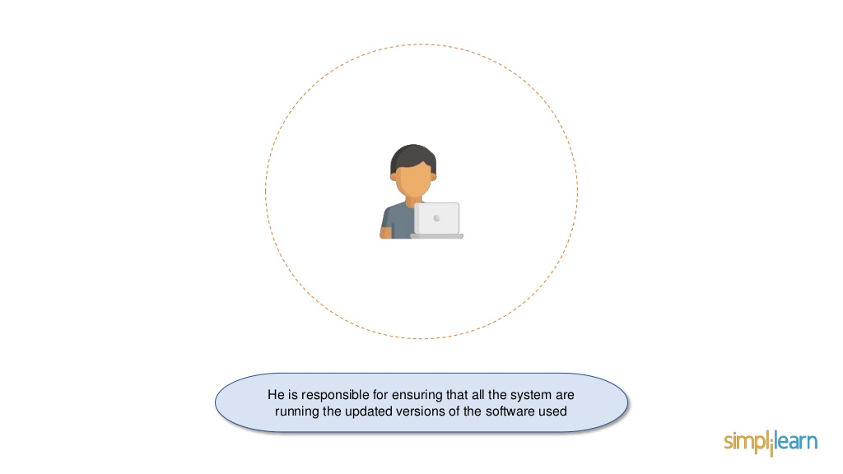
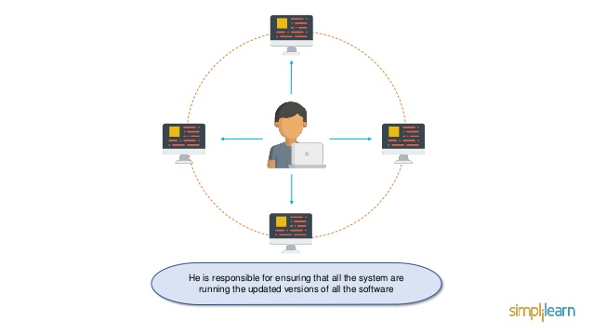
Why Ansible?

Slide 3
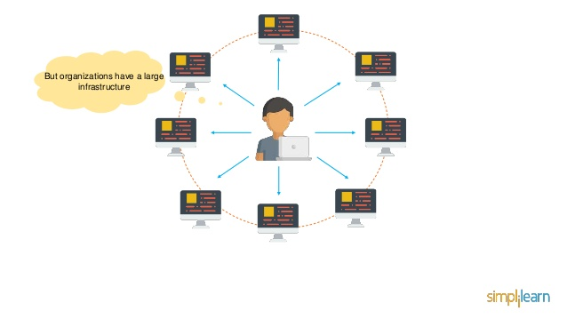
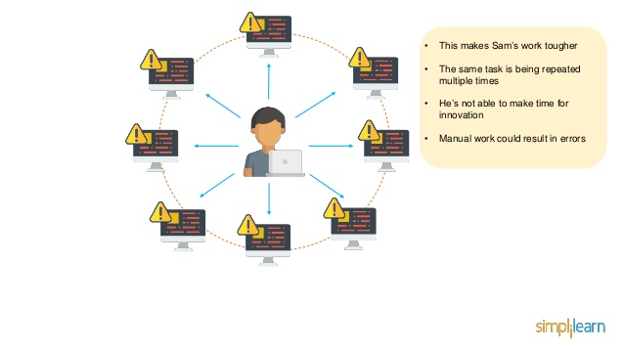
Then here is Scenario

Slide 4
Introduction
Open-Source automation tool
Help you with configuration Management, task automation, and Application installation, Orchestration etc...
This can be used for managing the Patch Management.
Unlike the puppet & chef there is no agent on the remote host.

Slide 5
Advantages
Free
Very Simple to setup and use
Agentless
powerful
Efficient
It uses simple YAML language
Push-Based Configuration

Slide 6
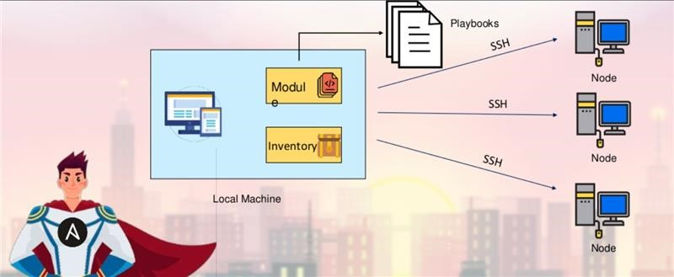
Ansible Architecture

Slide 7
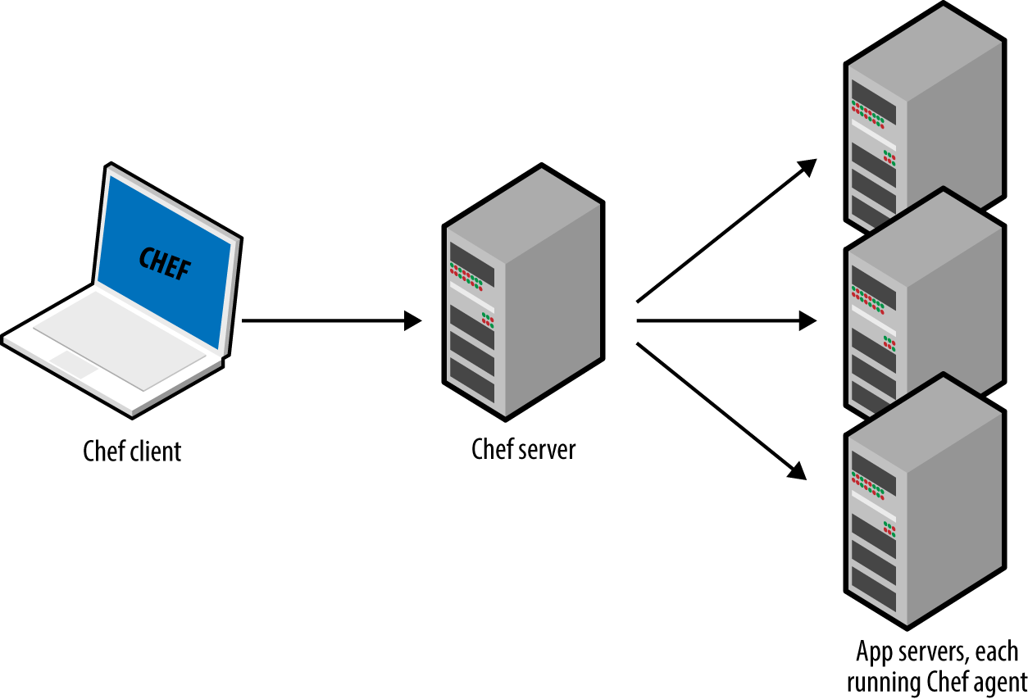
Chef diagram

Slide 8
Controller and Node
Controller : A controller is a Linux server that has Ansible installed on it
and it used for managing hosts or nodes
Node: The remote systems are known as Managed hosts or nodes.

